Slide 1
Module 1, Section 3: AWS Infrastructure Overview
© 2018, Amazon Web Services, Inc. or its Affiliates. All rights reserved.

Slide 2
What’s In This Module
Part 1: AWS Global Infrastructure
Notes:
In this module, we will review the AWS Global Infrastructure to understand the platform that hosts the AWS services.

Slide 3
Module Overview
Goal: Understand the AWS global infrastructure and the types of services that are available.
Examine the AWS global infrastructure
Understand the difference between AWS Regions, Availability Zones, and edge locations
Notes:
The goal of this module is to review the AWS Global Infrastructure to gain a clear understanding of what the infrastructure includes and what AWS Regions, Availability Zones, and edge locations are.

Slide 4
Part 1: AWS Global Infrastructure

Slide 5


AWS Global Infrastructure
Applications
Virtual Desktops
Collaboration and Sharing
Databases
Analytics
App Services
Deployment and Management
Mobile Services
Cluster Computing
Queuing
Containers
Identity
Relational
Orchestration
Platform Services
Real-time
Dev/ops Tools
App Streaming
Sync
No SQL
Data Warehouse
Resource Templates
Transcoding
Mobile Analytics
Email
Usage Tracking
Caching
Data Workflows
Notifications
Search
Monitoring and Logs
Foundation
Services
Compute
(Virtual, Auto-scaling and Load Balancing)
Networking
Storage
(Object, Block and Archive)
Infrastructure
Regions
Availability Zones
Edge Locations
Notes:
As we discussed earlier, AWS provides a broad set of services—such as compute power, storage options, networking, and databases—delivered as an on-demand utility that is available in seconds, with pay-as-you-go pricing. All of these services sit on AWS global infrastructure.
AWS’s global infrastructure can be broken down into three elements: Regions, Availability Zones, and edge locations.
Let’s take a more in depth look at the AWS infrastructure and see what these are.

Slide 6
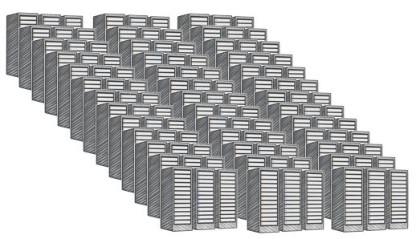
AWS Data Centers
Data centers are securely designed
A datacenter is a location where actual physical data resides
A data center typically has 50,000 to 80,000 physical servers
All data centers are online. No data center is “cold”
AWS custom network equipment:
Multi-ODM sourced
Amazon custom network protocol stack
Data center
Notes:
The foundation for the AWS infrastructure are the data centers. AWS data centers are built in clusters in various global regions. Key data center facts:
Data centers are designed with several factors in mind.
Each location is carefully evaluated to mitigate environmental risk.
Data centers have a redundant design that anticipates and tolerates failure while maintaining service levels.
To ensure availability, critical system components are backed up across multiple isolated locations known as Availability Zones.
To ensure capacity, AWS continuously monitors service usage to deploy infrastructure to support availability commitments and requirements.
Data center locations are not disclosed and all access to them is restricted.
In case of failure, automated processes move customer data traffic away from the affected area.
A single data center typically houses several thousand servers; larger data centers are undesirable.
All data centers are online and serving customers; no data center is “cold.”
AWS utilizes custom, multi-ODM sourced network equipment. ODM stands for original design manufacturer, which designs and manufactures products based on specifications from a second company. The second company then rebrands the products for sale.
For more information on AWS data centers, see https://aws.amazon.com/compliance/data-center/.

Slide 7

AWS Regions
An AWS Region is a geographical area.
Each Region is made up of two or more Availability Zones.
AWS has 18 Regions worldwide.
You enable and control data replication across Regions.
Communication between Regions uses AWS backbone network connections infrastructure.
Data center
Data center
Data center
Data center
Data center
Data center
Data center
Data center
Availability Zone
Availability Zone
Data center
Data center
Data center
Data center
Availability Zone
AWS Region
Notes:
The AWS Cloud infrastructure is built around Regions and Availability Zones (AZs).
An AWS Region is a physical location in the world where we have multiple AZs. To achieve fault tolerance and stability, regions are isolated from one another. Resources in one region are not automatically replicated to other regions. Each AWS Region contains two or more Availability Zones.
When you store data in a specific region, it is not replicated outside that region. AWS never moves your data out of the region you put it in. It is your responsibility to replicate data across regions, if your business needs require that. AWS provides information about the country, and—where applicable—the state where each region resides; you are responsible for selecting the region to store data in based on your compliance and network latency requirements. When you distribute applications across multiple Availability Zones, be aware of location-dependent privacy and compliance requirements, such as the EU Data Privacy Directive. When selecting a region, it is also important to consider which region will help you optimize latency while minimizing costs and adhering to whatever regulatory requirements you may have.
Let’s dive deeper on this point. If you are leveraging cloud computing services you can easily deploy your application in multiple regions. For instance, you can have an application in a region nearest your headquarters such as San Diego and then also have a deployable application in a region in the East Coast. Let’s say your largest customer base is located in Virginia. Within a few clicks of your mouse, you can easily deploy in the US East region to provide a better experience for your customers. You will be minimizing latency and increasing agility for your organization within minutes and with minimal cost.

Slide 8

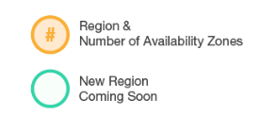
AWS Global Infrastructure: Current Regions
IRELAND
CANADA
3
BEIJING
OHIO
3
3
FRANKFURT
NINGXIA
OREGON
3
2
LONDON
3
SEOUL
3
3
PARIS
2
2
3
6
2
4
N. CALIFORNIA
1
TOKYO
N. VIRGINIA
OSAKA
AWS GOVCLOUD (US-WEST)
2
MUMBAI
3
SINGAPORE
Region & Number of AZs
3
SÃO PAULO
3
SYDNEY
Notes:
To see the regions currently available, navigate to AWS homepage (https://aws.amazon.com) and scroll down to global network of regions and edge locations in the middle of the page. Edge locations can be found at https://aws.amazon.com/cloudfront/details/.
The isolated GovCloud (US) Region is designed to allow US government agencies and customers to move sensitive workloads into the cloud by addressing their specific regulatory and compliance requirements.

Slide 9

AWS Global Infrastructure: Regions Coming Soon
AWS GOVCLOUD (US-EAST)
(Coming soon)
IRELAND
SWEDEN (Coming soon)
CANADA
3
BEIJING
OHIO
3
3
FRANKFURT
NINGXIA
OREGON
3
2
LONDON
3
SEOUL
3
3
PARIS
2
2
3
6
2
4
N. CALIFORNIA
1
TOKYO
N. VIRGINIA
BAHRAIN (Coming soon)
OSAKA
AWS GOVCLOUD (US-WEST)
2
HONG KONG (Coming soon)
MUMBAI
3
SINGAPORE
Region & Number of AZs
3
SÃO PAULO
3
New Region Coming Soon
SYDNEY
Notes:
AWS products and services are available by region so you may not see all regions available for a given service. AWS is steadily expanding its global infrastructure to help customers achieve lower latency and higher throughput and to ensure that your data resides only in the region you specify.
The AWS Cloud has announced plans to expand with 17 new Availability Zones in four new geographic Regions: Bahrain, Hong Kong, Sweden, and a second AWS GovCloud Region in the eastern US.
For more information about global infrastructure, see http://aws.amazon.com/about-aws/globalinfrastructure/.

Slide 10
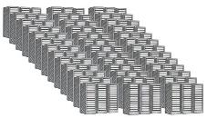
AWS Availability Zones
Each Availability Zone is:
Made up of one or more data centers.
Designed for fault isolation.
Interconnected with other Availability Zones using high-speed private links.
You choose your Availability Zones.
AWS recommends replicating across Availability Zones for resiliency.
Data Center
Data Center
Data Center
Data Center
Availability Zone
Notes:
Availability Zones(AZs) consist of one or more discrete data centers, each with redundant power, networking, and connectivity, housed in separate facilities. Some Availability Zones have as many as six data centers; however, no data center can be part of two Availability Zones.
Each Availability Zone is designed as an independent failure zone. This means that Availability Zones are physically separated within a typical metropolitan region and are located in lower-risk flood plains (specific flood-zone categorization varies by region). In addition to having discrete uninterruptable power supply and onsite backup generation facilities, they are each fed via different grids from independent utilities to further reduce single points of failure. Availability Zones are all redundantly connected to multiple tier-1 transit providers. AZs in a region are connected through low-latency links.
You are responsible for selecting the Availability Zones where your systems will reside. Systems can span multiple Availability Zones. You should design your systems to survive temporary or prolonged failure of an Availability Zone if a disaster occurs. Distributing applications across multiple Availability Zones allows them to remain resilient in most failure situations, including natural disasters or system failures.

Slide 11
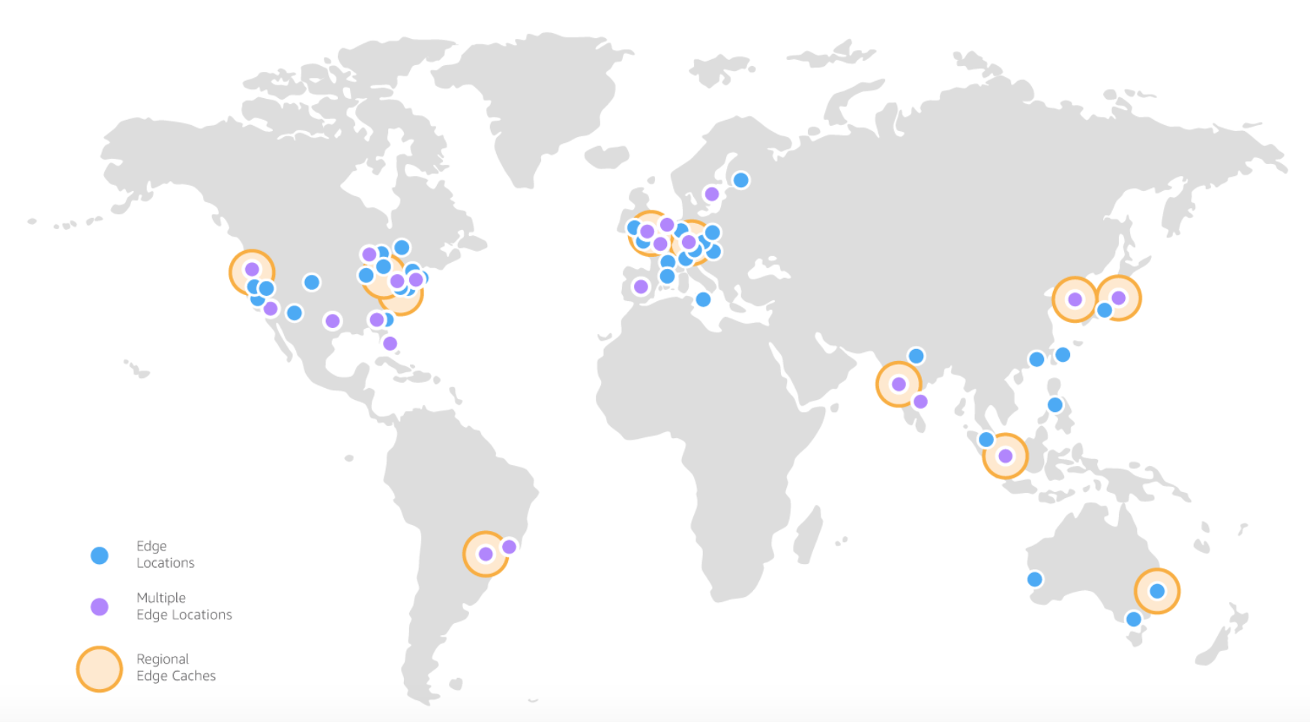
AWS Edge Locations
An edge location is where users access AWS services.
It is a global network of 114 points of presence (103 edge locations and 11 regional edge caches) in 56 cities across 24 countries.
Specifically used with Amazon CloudFront, a global content delivery network (CDN), to deliver content to end users with reduced latency.
Regional edge caches used for content with infrequent access.
Notes:
An edge location is where end users access AWS services.
They are located in most of the major cities around the world and serve requests for Amazon CloudFront and Amazon Route 53. Edge locations are currently located in North America, Europe, Asia, Australia, and South America. AWS Edge locations offer CloudFront, Amazon Route 53, AWS Shield, and AWS Web Application Firewall (WAF) services.
CloudFront is a content delivery network (CDN) used to distribute content to end users to reduce latency. Amazon Route 53 is a DNS service. Requests going to either one of these services will be routed to the nearest edge location automatically.
Regional edge caches, used by default with Amazon CloudFront, are utilized when you have content that is not accessed frequently enough to remain in an edge location. Regional edge caches absorb this content and provide an alternative to that content having to be fetched from the origin server.

Slide 12



AWS Infrastructure Features
Elastic and Scalable
Elastic infrastructure; dynamic adaption of capacity
Scalable infrastructure; adapts to accommodate growth
Fault-tolerant
Continues operating properly in the presence of a failure
Built-in redundancy of components
High availability
High level of operational performance
Minimized downtime
No human intervention
Physically distinct
Backup generators
Data center
Data center
Data center
Data center
Data center
Data center
Data center
Data center
Availability Zone
Availability Zone
Network connectivity
Data center
Data center
Data center
Data center
Availability Zone
Uninterruptible power supply
Cooling equipment
AWS Region
Notes:
The AWS Cloud infrastructure is built around Regions and Availability Zones. AWS Regions provide multiple, physically separated and isolated Availability Zones. An AWS Region contains two or more Availability Zones. An Availability Zone is a data center (or collection of data centers). Availability Zones are connected with low latency, high throughput, and highly redundant networking. Availability Zones are physically distinct and each has equipment like uninterruptible power supplies, cooling equipment, backup generators and security to ensure uninterrupted operations.
This infrastructure has several valuable features:
First, it is elastic and scalable. This means resources can dynamically adjust to increases or decreases in capacity requirements. It can also rapidly adjust to accommodate growth.
Second, this infrastructure is fault tolerant which means it has built-in component redundancy which enables it to continue operations despite a failed component.
Finally, it requires minimal to no human intervention while providing high availability with minimal down time.

Slide 13


Summary
Examined the AWS Global Infrastructure to understand:
Data centers
Regions
Availability Zones
Edge locations
To finish this module:
Complete:
Knowledge Assessment

Slide 14
Up Next: Module 2 – AWS Core Services - Compute Overview of Services Managed and Unmanaged Services Introduction to Compute Services
Notes:
In Unit 2, we look at the core Amazon Web Services (AWS) to better understand the specifics of each service. We will start in Module 2, Unit 1 with an overview of services, a review of the meaning of managed and unmanaged services, and a discussion of compute services.

Slide 15
Image Sources
https://flic.kr/p/oxtQ9k
https://pixabay.com/en/binary-one-null-ball-binary-code-208216/
https://commons.wikimedia.org/wiki/File:123Net_Data_Center_(DC2).jpg
https://pixabay.com/en/hammer-wrench-repair-work-industry-28636/
http://res.freestockphotos.biz/pictures/15/15157-illustration-of-a-key-pv.png
Notes:
This slide contains attributions for any Creative Commons-licensed images used within this module.

Slide 16
Thanks for participating!
© 2018 Amazon Web Services, Inc. or its affiliates. All rights reserved. This work may not be reproduced or redistributed, in whole or in part, without prior written permission from Amazon Web Services, Inc. Commercial copying, lending, or selling is prohibited. Corrections or feedback on the course, please email us at: aws-course-feedback@amazon.com. For all other questions, contact us at: https://aws.amazon.com/contact-us/aws-training/. All trademarks are the property of their owners.

